Slide 1

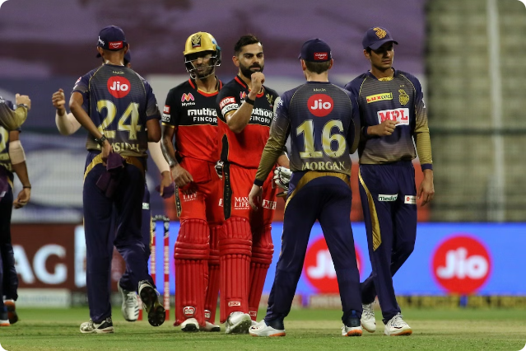
Machine Learning Project:
IPL Win Predictor
Presented By: Ashish Kumar
College Name: GITA Autonomous College, Bhubaneswar
Department: Computer Science And Technology

Slide 2

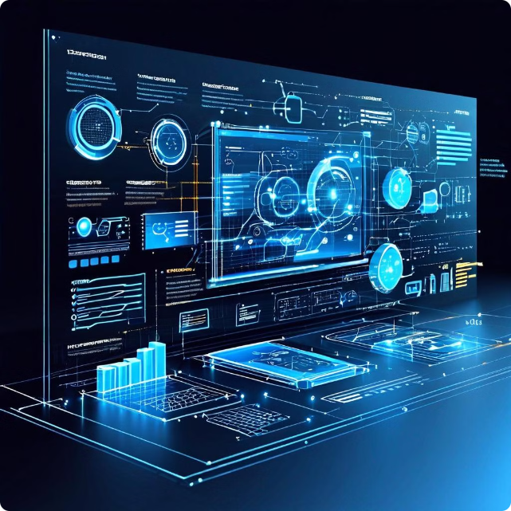
Outline
Problem Statement
Proposed Solution
System Development Approach
Model Development
Model Performance Evaluation
Dynamic Match Prediction Evaluation
User Interface with Streamlit
Integration and Deployment
Result
Conclusion
Future Scope
References

Slide 3

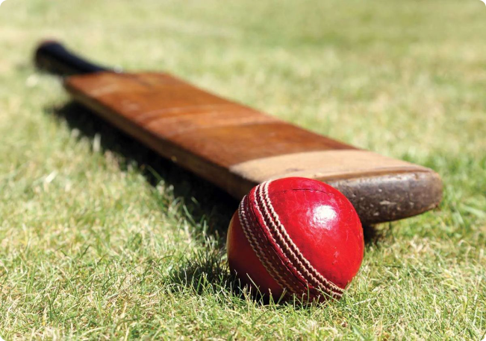
Problem Statement
Predicting IPL match outcomes is challenging due to the dynamic nature of the sport. Numerous factors, including team form, player performance, and match conditions, can influence the result.
1
Inconsistency
Teams often exhibit unpredictable performance, making it difficult to forecast outcomes with high accuracy.
2
External Factors
Factors like weather, pitch conditions, and player injuries can significantly impact match results.
3
Limited Data
The availability of historical data for IPL matches is relatively limited, making it challenging to train accurate predictive models.

Slide 4
Proposed Solution
The proposed solution involves developing an AI model that learns from historical IPL match data to predict future outcomes. The model will incorporate various factors, such as team statistics, player performance, and match venues, to generate accurate predictions.
Data Collection
Model Training
Prediction
Gather historical IPL data, including match results, team statistics, player performance, and match conditions.
Develop a machine learning model using the collected data to learn patterns and relationships that predict match outcomes.
Deploy the trained model to generate predictions for future IPL matches based on real-time data.

Slide 5
System Development Approach
Data Acquisition
1
Collecting and cleaning historical IPL match data.
2
Feature Engineering
Extracting relevant features like team, score, wickets, run rate.
EDA
3
Data analysis to identify key features for model training.
4
Model Selection
Choosing logistic regression based on data characteristics.
Model Training
5
Training the model to learn patterns and predict outcomes.
6
Model Evaluation
Ensuring accuracy and generalizability on unseen data.
Model Integration With UI
7
Integrating the model with Streamlit frontend.
8
Deployment
Deploying the model as a web application.

Slide 6
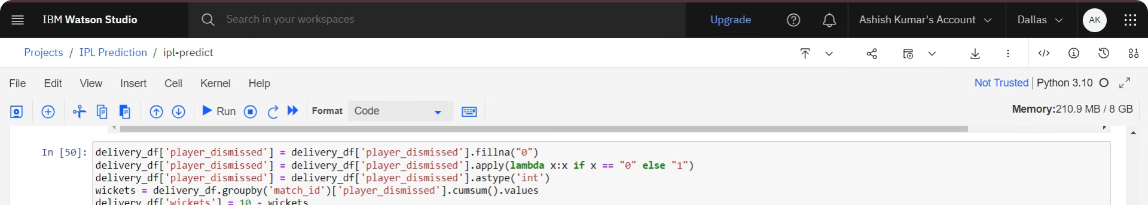
Model Development
The model is developed using IBM Watson Studio, a powerful data science platform that provides a Jupyter Notebook environment for building and training machine learning models. Within the Jupyter Notebook, I leveraged various data analysis and feature engineering techniques to prepare the historical IPL match data for model training.
The team utilized logistic regression machine learning algorithms to train the model and learn the patterns and relationships that predict match outcomes. Throughout the development process, the model's performance was rigorously evaluated on unseen data to ensure its accuracy and generalizability.
By harnessing the capabilities of IBM Watson Studio, I was able to efficiently iterate on the model, fine-tune the hyperparameters, and ultimately deliver a robust and reliable IPL match predictor that can be seamlessly integrated into the frontend application for users to explore and utilize.

Slide 7

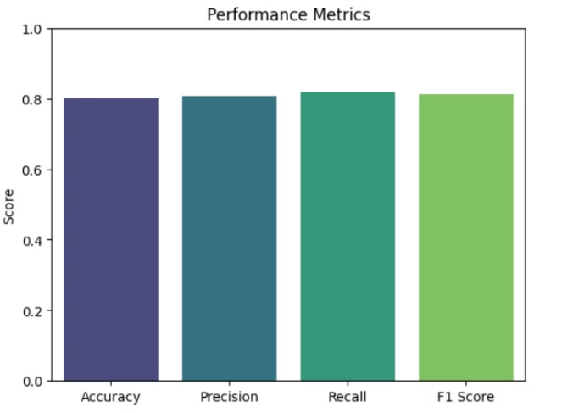
Model Performance Evaluation
The performance of the developed model will be evaluated using various metrics, such as accuracy, precision, recall, and F1-score, to determine its effectiveness in predicting IPL match outcomes.
Metric
Definition
Target Value
Accuracy
Percentage of correctly predicted outcomes.
Above 80%
Precision
Proportion of correctly predicted wins out of all predicted wins.
Above 80%
Recall
Proportion of correctly predicted wins out of all actual wins.
Above 81%
F1-score
Harmonic mean of precision and recall.
Above 81%

Slide 8
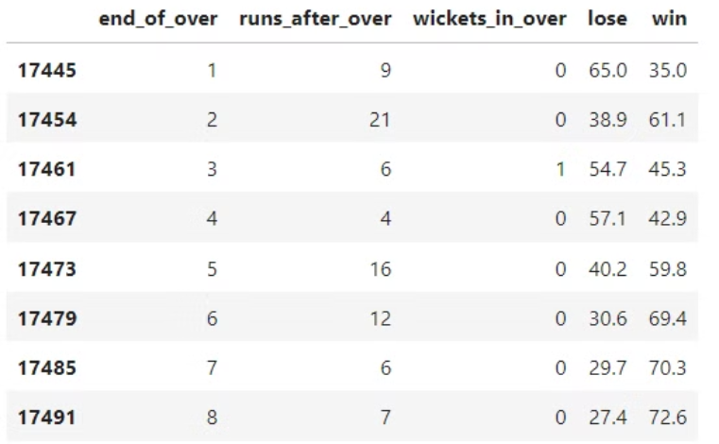
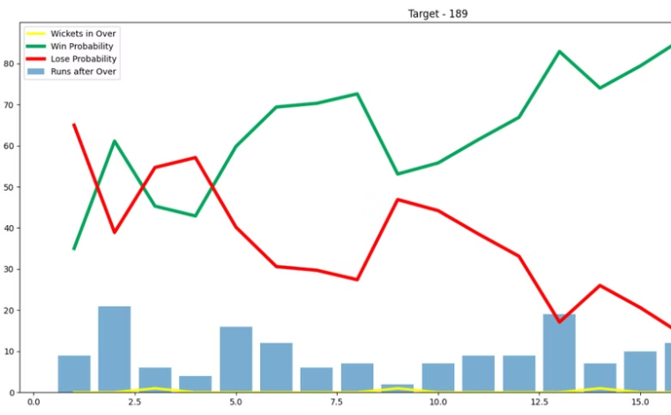
Dynamic Match Prediction Evaluation
Detailed Data Table
Visualize the Match Progress
The table lists the progress of the match over each over, showing runs scored, wickets taken, and win/loss probabilities. This allows you to see how the dynamics of the match change with each over.
The graph provides a visual representation of the same data, with blue bars for runs, yellow lines for wickets, and green/red lines for win and loss probabilities. This gives a comprehensive understanding of the match's progress and the impact of each over.

Slide 9

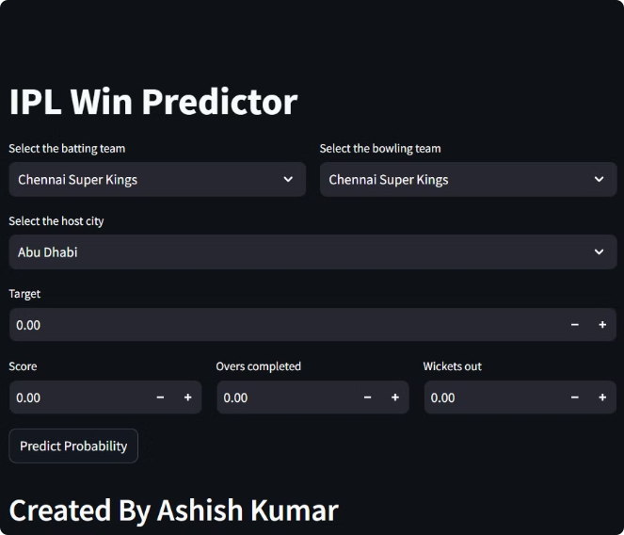
User Interface With Streamlit
Streamlit is used to create an interactive web application for the IPL Win Predictor, offering an intuitive and responsive user interface for engaging with the prediction model.
Form Inputs
Users can easily enter match details such as team names, venue, target score, and other relevant information.
Simple Navigation
The application features clear menus and options for accessing match schedules, team information, and prediction inputs.
Ease of Use
The design prioritizes simplicity, ensuring that users can quickly and accurately input data without confusion.
Dynamic Adjustments
Users can modify inputs on the fly to see how different factors affect the prediction outcome in real-time.

Slide 10





Integration And Deployment
Frontend Integration
Integrate the model with frontend web app to retrieve real-time match information.
Data Processing
Prepare the data for seamless integration with the trained machine learning model.
Prediction Generation
Leverage the model to generate accurate match outcome predictions.
Display Results
Present the predictions to users in a clear, user-friendly format.
Deployment
Deploy the web application on Streamlit, making the IPL predictor accessible to users.
https://ipl-win-predictor-yq.streamlit.app/

Slide 11
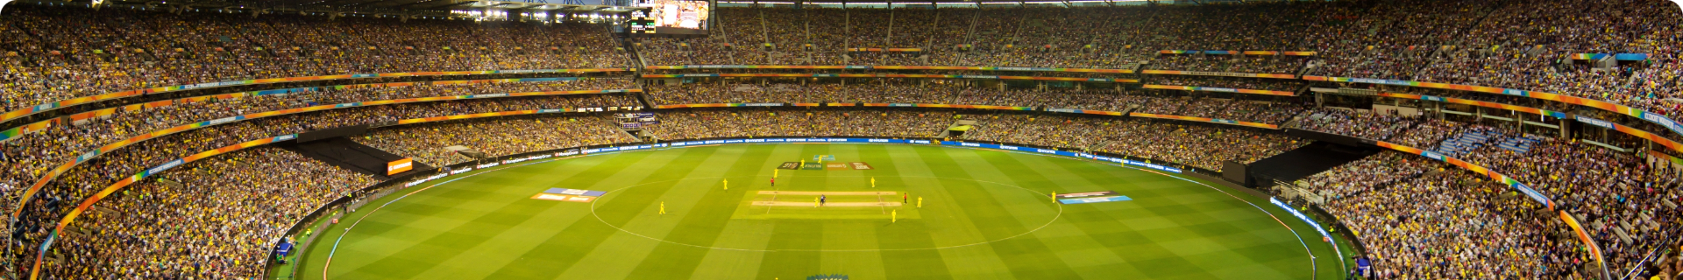



Result
The development of an AI-powered IPL win predictor has the potential to revolutionize the way fans engage with the tournament. By providing accurate and reliable predictions, the system can enhance the viewing experience and contribute to a deeper understanding of the game.
Increased Engagement
Enhanced Decision-Making
Data-Driven Insights
The predictor can increase fan engagement by providing insights and predictions that enhance the viewing experience.
The predictor can assist fantasy cricket players in making informed decisions by providing predictions based on data analysis.
The predictor can provide data-driven insights into team performance, player statistics, and match outcomes, contributing to a deeper understanding of the game.

Slide 12
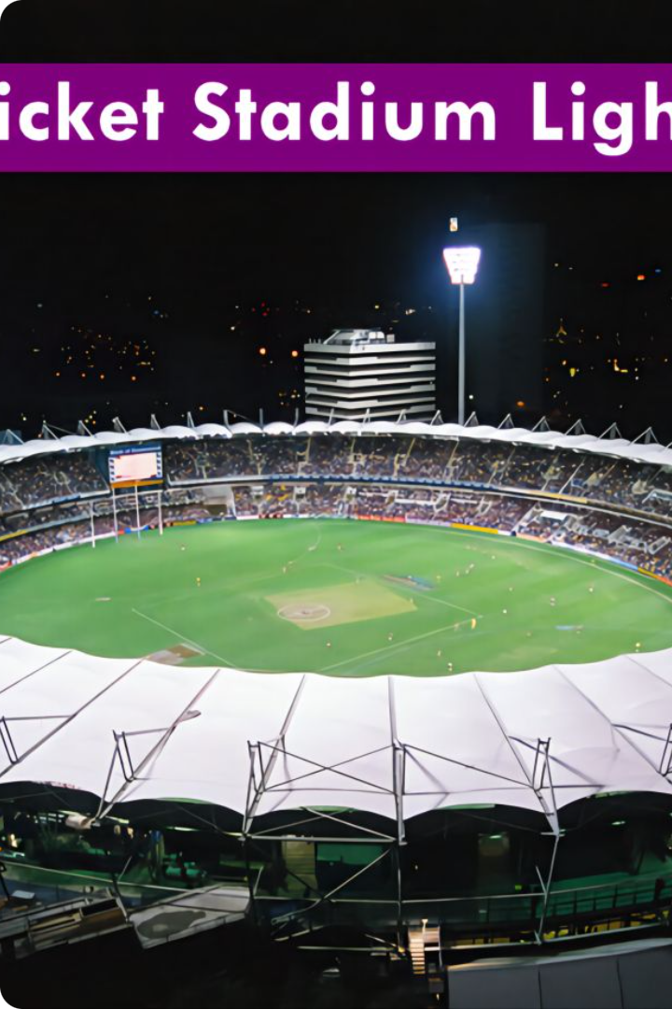
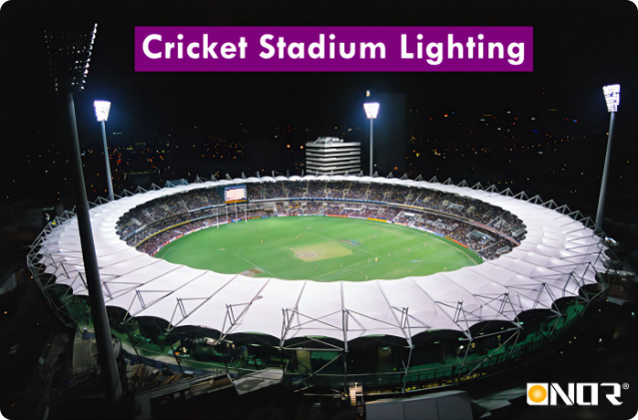
Conclusion
The development of an AI-powered IPL win predictor presents a compelling opportunity to leverage the power of machine learning to enhance the viewing experience and provide valuable insights for fans, players, and stakeholders. By accurately predicting match outcomes, the system can revolutionize the way fans engage with the tournament.

Slide 13

Future Scope
The developed IPL win predictor has the potential for further development and expansion to include additional features and functionalities.
1
Real-Time Data Integration
2
Advanced Machine Learning Techniques
Integrating real-time data streams, such as player performance updates and weather conditions, to enhance the accuracy of predictions.
Exploring advanced machine learning algorithms, such as deep learning and reinforcement learning, to further improve prediction accuracy.
3
Personalized Recommendations
4
Social Integration
Developing personalized features that recommend matches based on user preferences, such as favorite teams or players.
Integrating social media features to allow users to share predictions and engage with other fans.

Slide 14
References
GeeksForGeeks
IBM Watson Studio Docs
Kaggle
Streamlit Docs

Slide 15
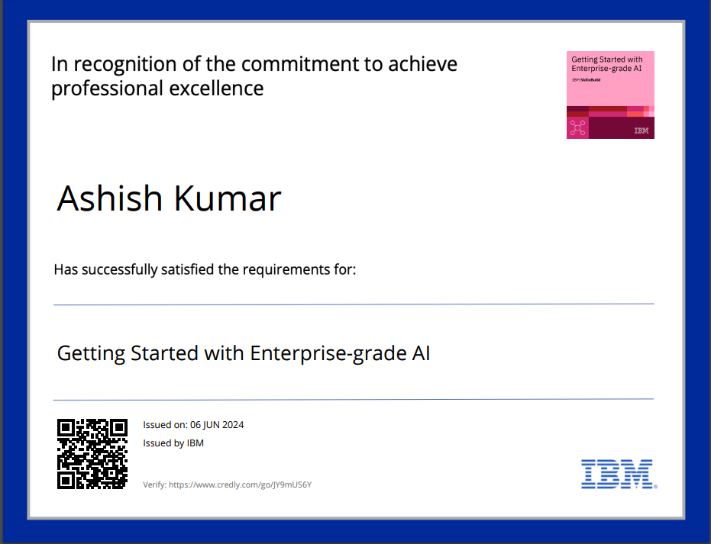
Course Certificate 1: Enterprise Grade AI
Verification Link: Click here

Slide 16
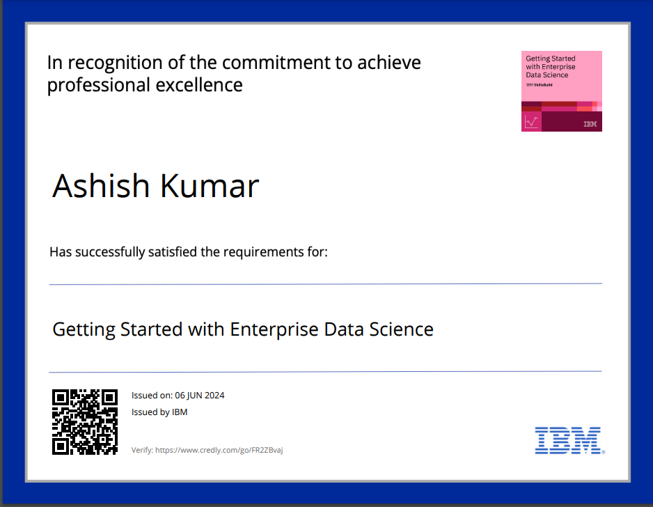
Course Certificate 2: Enterprise Grade Data Science
Verification Link: Click here

Slide 17

Thank You
Name: Ashish Kumar
Email: ashishkumat818@gmail.com
LinkedIn: ashish-kr01
Github: ashishkr678
Project Repository: https://github.com/ashishkr678/ipl-win-predictor
Project Website Link: https://ipl-win-predictor-yq.streamlit.app/

